Slide 1
AI-Powered Artist Promotion Assistant – Final Demo Proof of Concept Kaylee Auguillard, Bradley Johnson, Florentin Degbo, Stanley Huynh

Slide 2
Project Overview
Purpose: Help independent artist grow online presence using AI.
Key Features
Simulated monitoring of social interactions using mock JSON data
Rule-based opportunity scoring (sentiment, relevance, priority, engagement probability)
AI-generated brand-voice reply suggestions
Artist approval workflow for all responses
Simulated KPI dashboard showing performance metrics and revenue estimates
Simulated Data
Artist Approval
Scoring Engine
AI Draft Reply
KPI Dashboard

Slide 3
Business Case
Why it matters:
Artists often lack time and data to make informed marketing decisions.
Our system identifies high-impact engagement opportunities in real time.
Benefits demonstrated in testing:
Increased engagement
Improved reach and content optimization
Better ROI on social campaigns

Slide 4
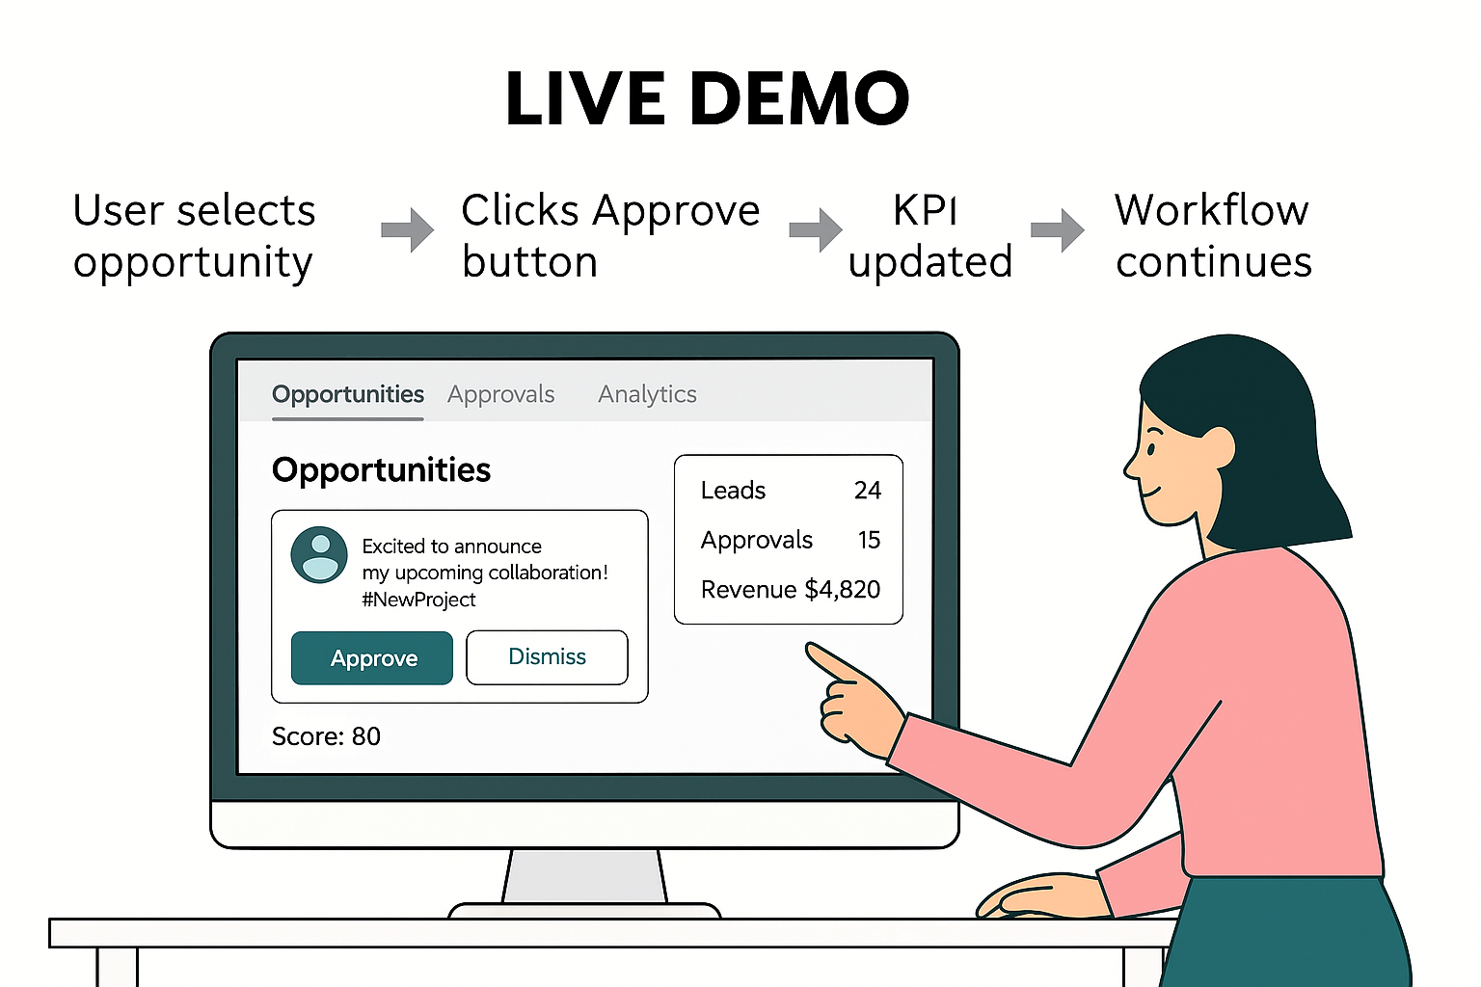
LIVE DEMO

Slide 5
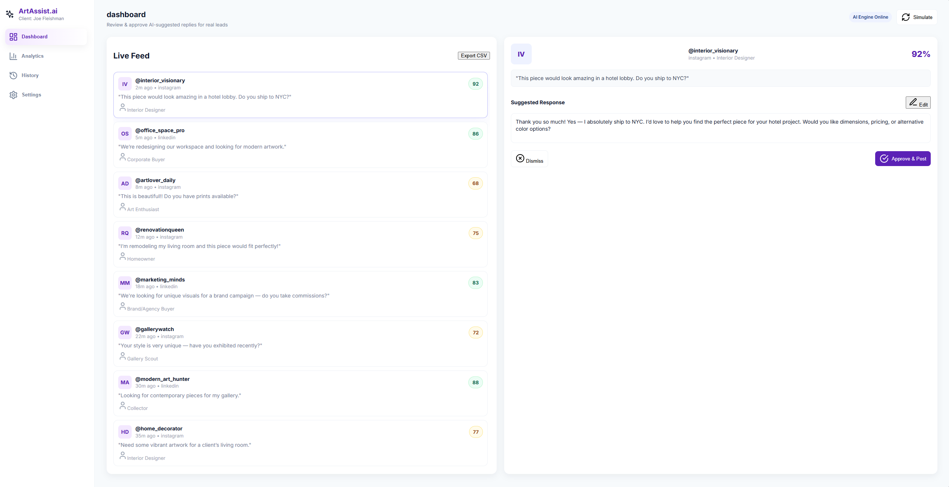
Solution Overview
Real-time monitoring of at least 2 platforms.
AI identifies trends, engagement spikes, and growth opportunities.
Scores and ranks actions by potential impact.

Slide 6
Architecture / How It Works
Data Input (Simulated): Mock JSON datasets simulate leads from two online platforms.
AI Scoring Engine (Rule-Based): Custom scoring formula based on sentiment, relevance, priority, and engagement probability.
Brand-Voice Response Generator: AI produces draft responses aligned with the artist’s tone; artist approves/edits.
Artist Dashboard (Frontend): View leads, approve responses, and track analytics from the mock dataset.
Analytics Module (Simulated KPIs): Displays approvals, dismissals, CTR, and estimated revenue using mock data.

Slide 7
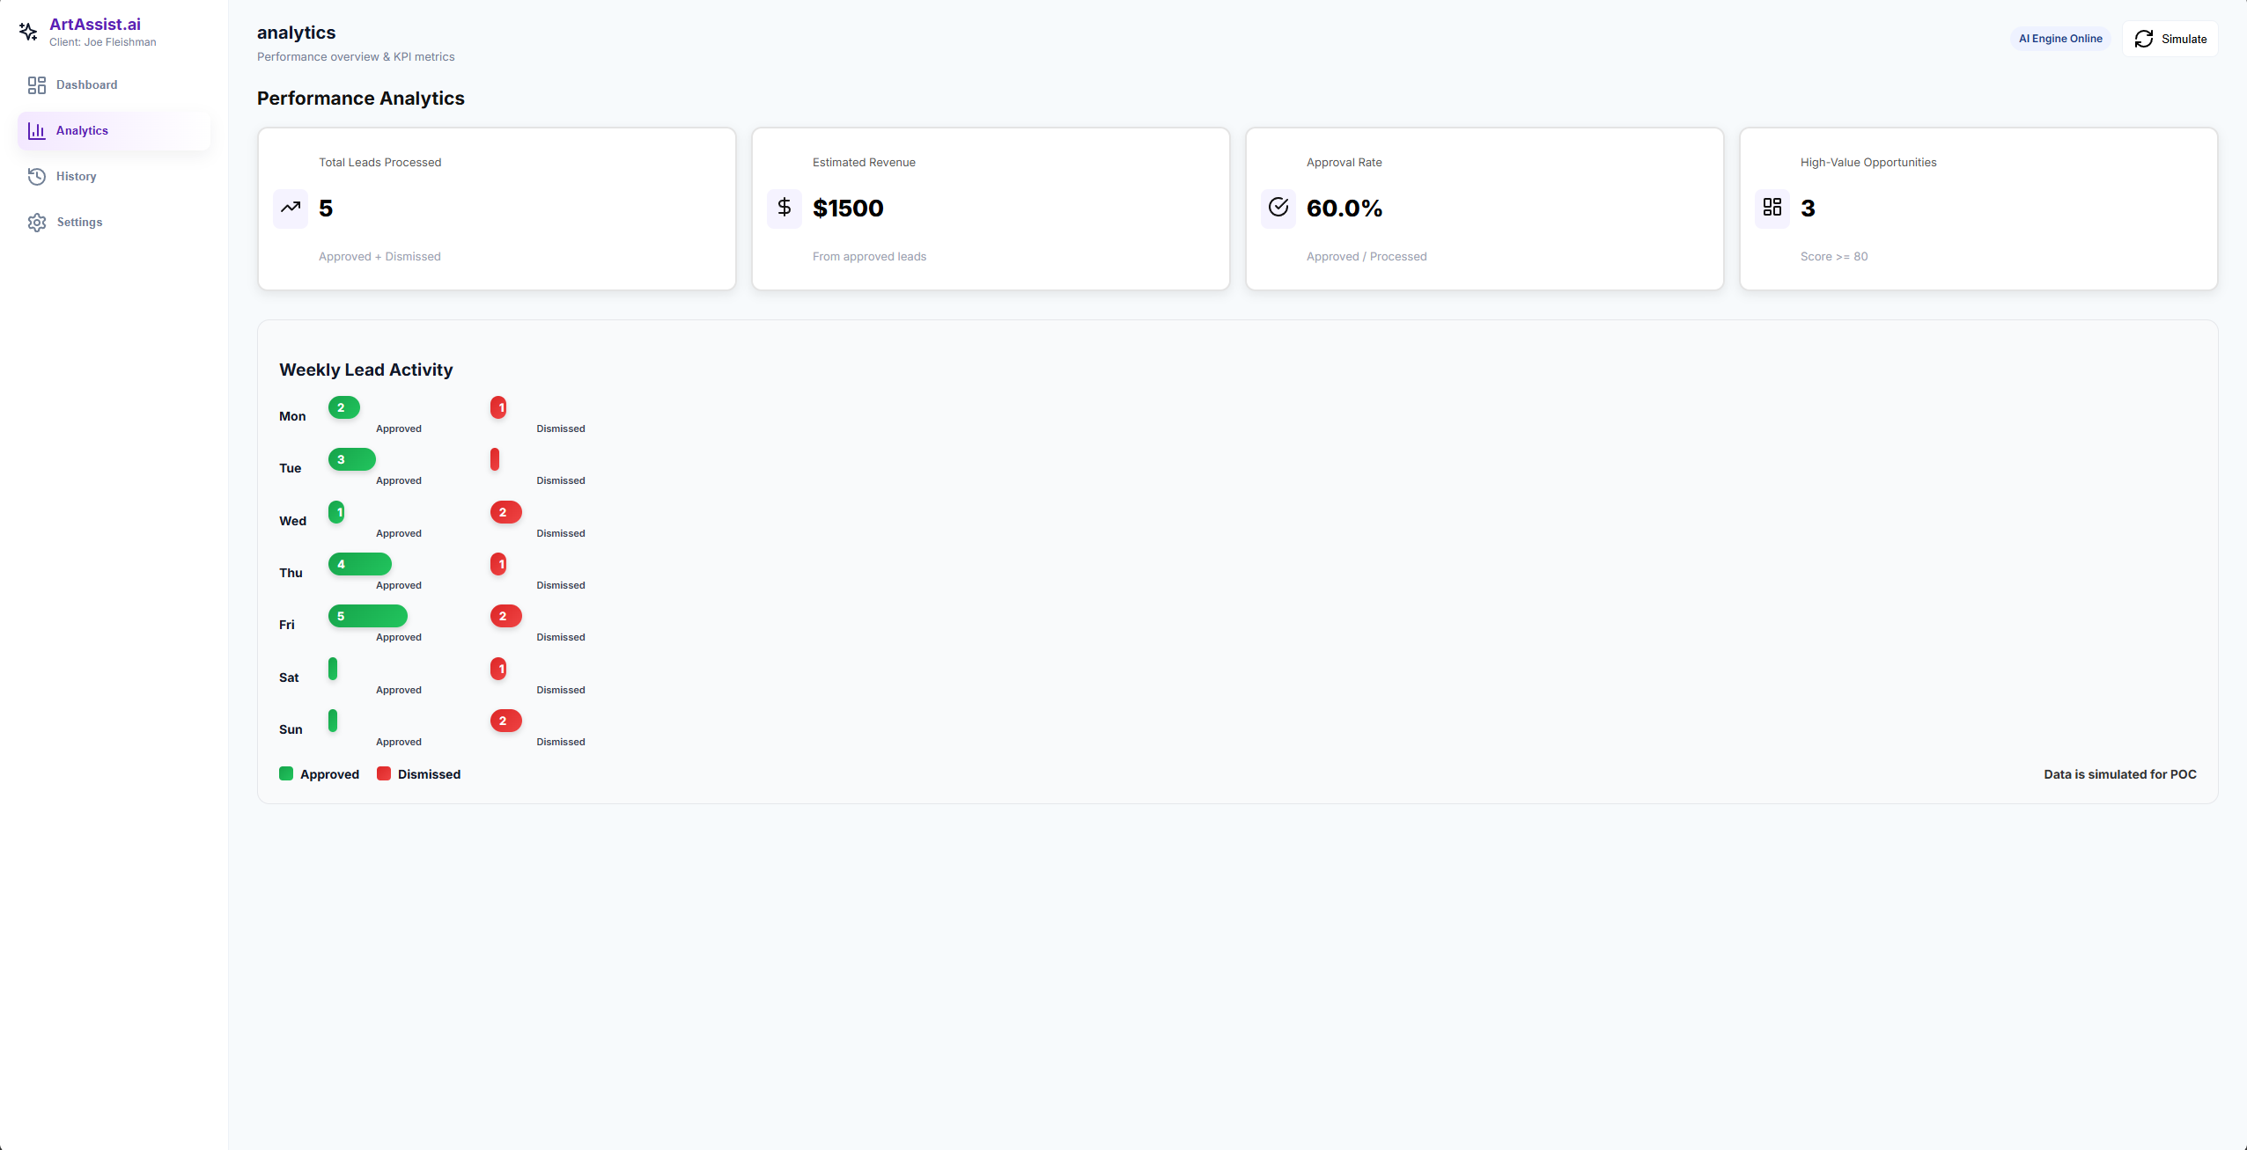
Performance Metrics
Total Leads Processed: 5
Approval Rate: 60%
High-Value Opportunities: 3
Estimated Revenue: $1,500
Insights: Fridays yield the highest approval; focus AI recommendations on high-value days.

Slide 8
Lessons Learned
Challenges encountered: API limitations, real-time scoring, platform variability.
Solutions & insights:
Caching & parallel processing for performance
Adaptive scoring models
Importance of real-time data validation
Rule-based scoring can quickly approximate opportunity value.
Brand-voice AI generation increases speed of engagement. Human approvals remain essential for authenticity.
Simulated KPI tracking helps model real business workflows
Full production features require API access + database + security
Ethical transparency (simulated data, human-in-the-loop) builds trust

Slide 9
Future Roadmap
Phase 1 – Production Readiness
Add secure login & user authentication
Connect to Instagram, TikTok, YouTube APIs
Implement real database (MongoDB / PostgreSQL)
Build real-time analytics engine
Phase 2 – AI Intelligence
ML-based scoring model
Sentiment analysis using NLP
Buyer intent prediction
Predictive ROI modeling

Slide 10
Future Roadmap
Phase 3 – Automation & Scaling
Auto-response delivery (human-approved)
CRM integration (HubSpot / Salesforce)
Multi-artist portfolio management
Campaign performance optimization
Phase 4 – Commercialization
Subscription-based SaaS product
White-label dashboards
Data visualizations for agencies
Enterprise security upgrade

Slide 11
Thank you

